Slide 1
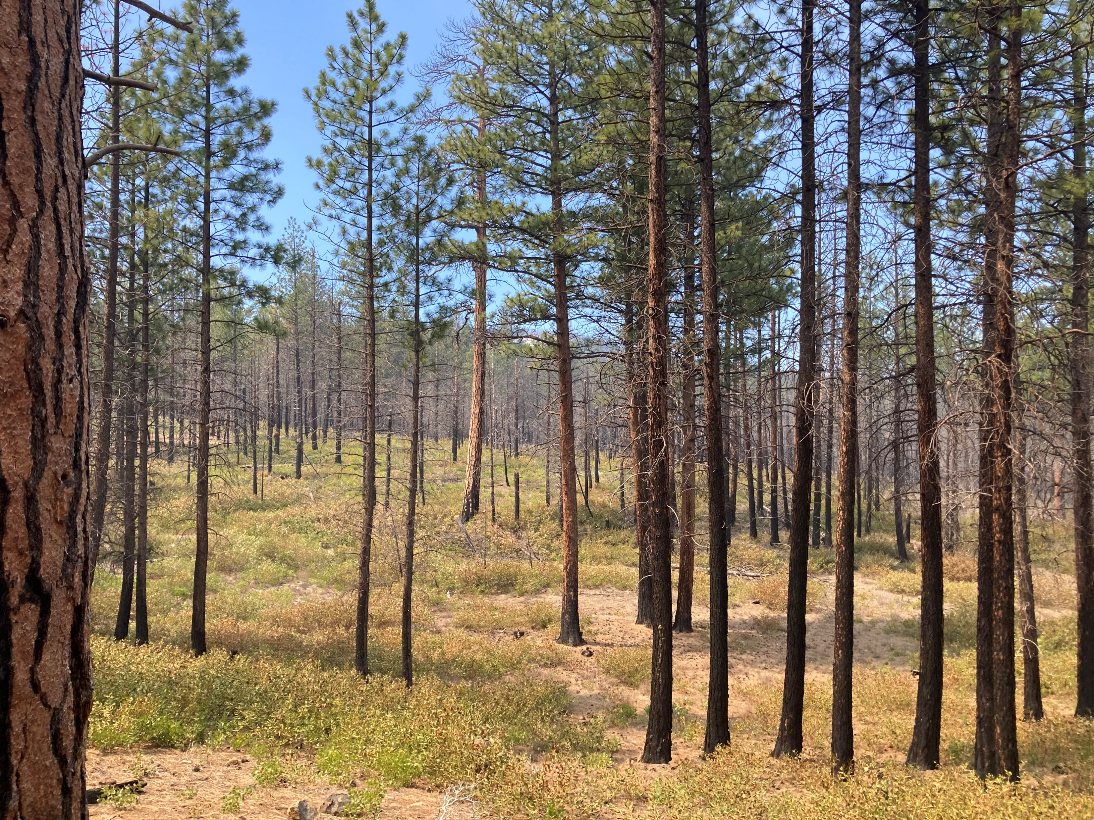
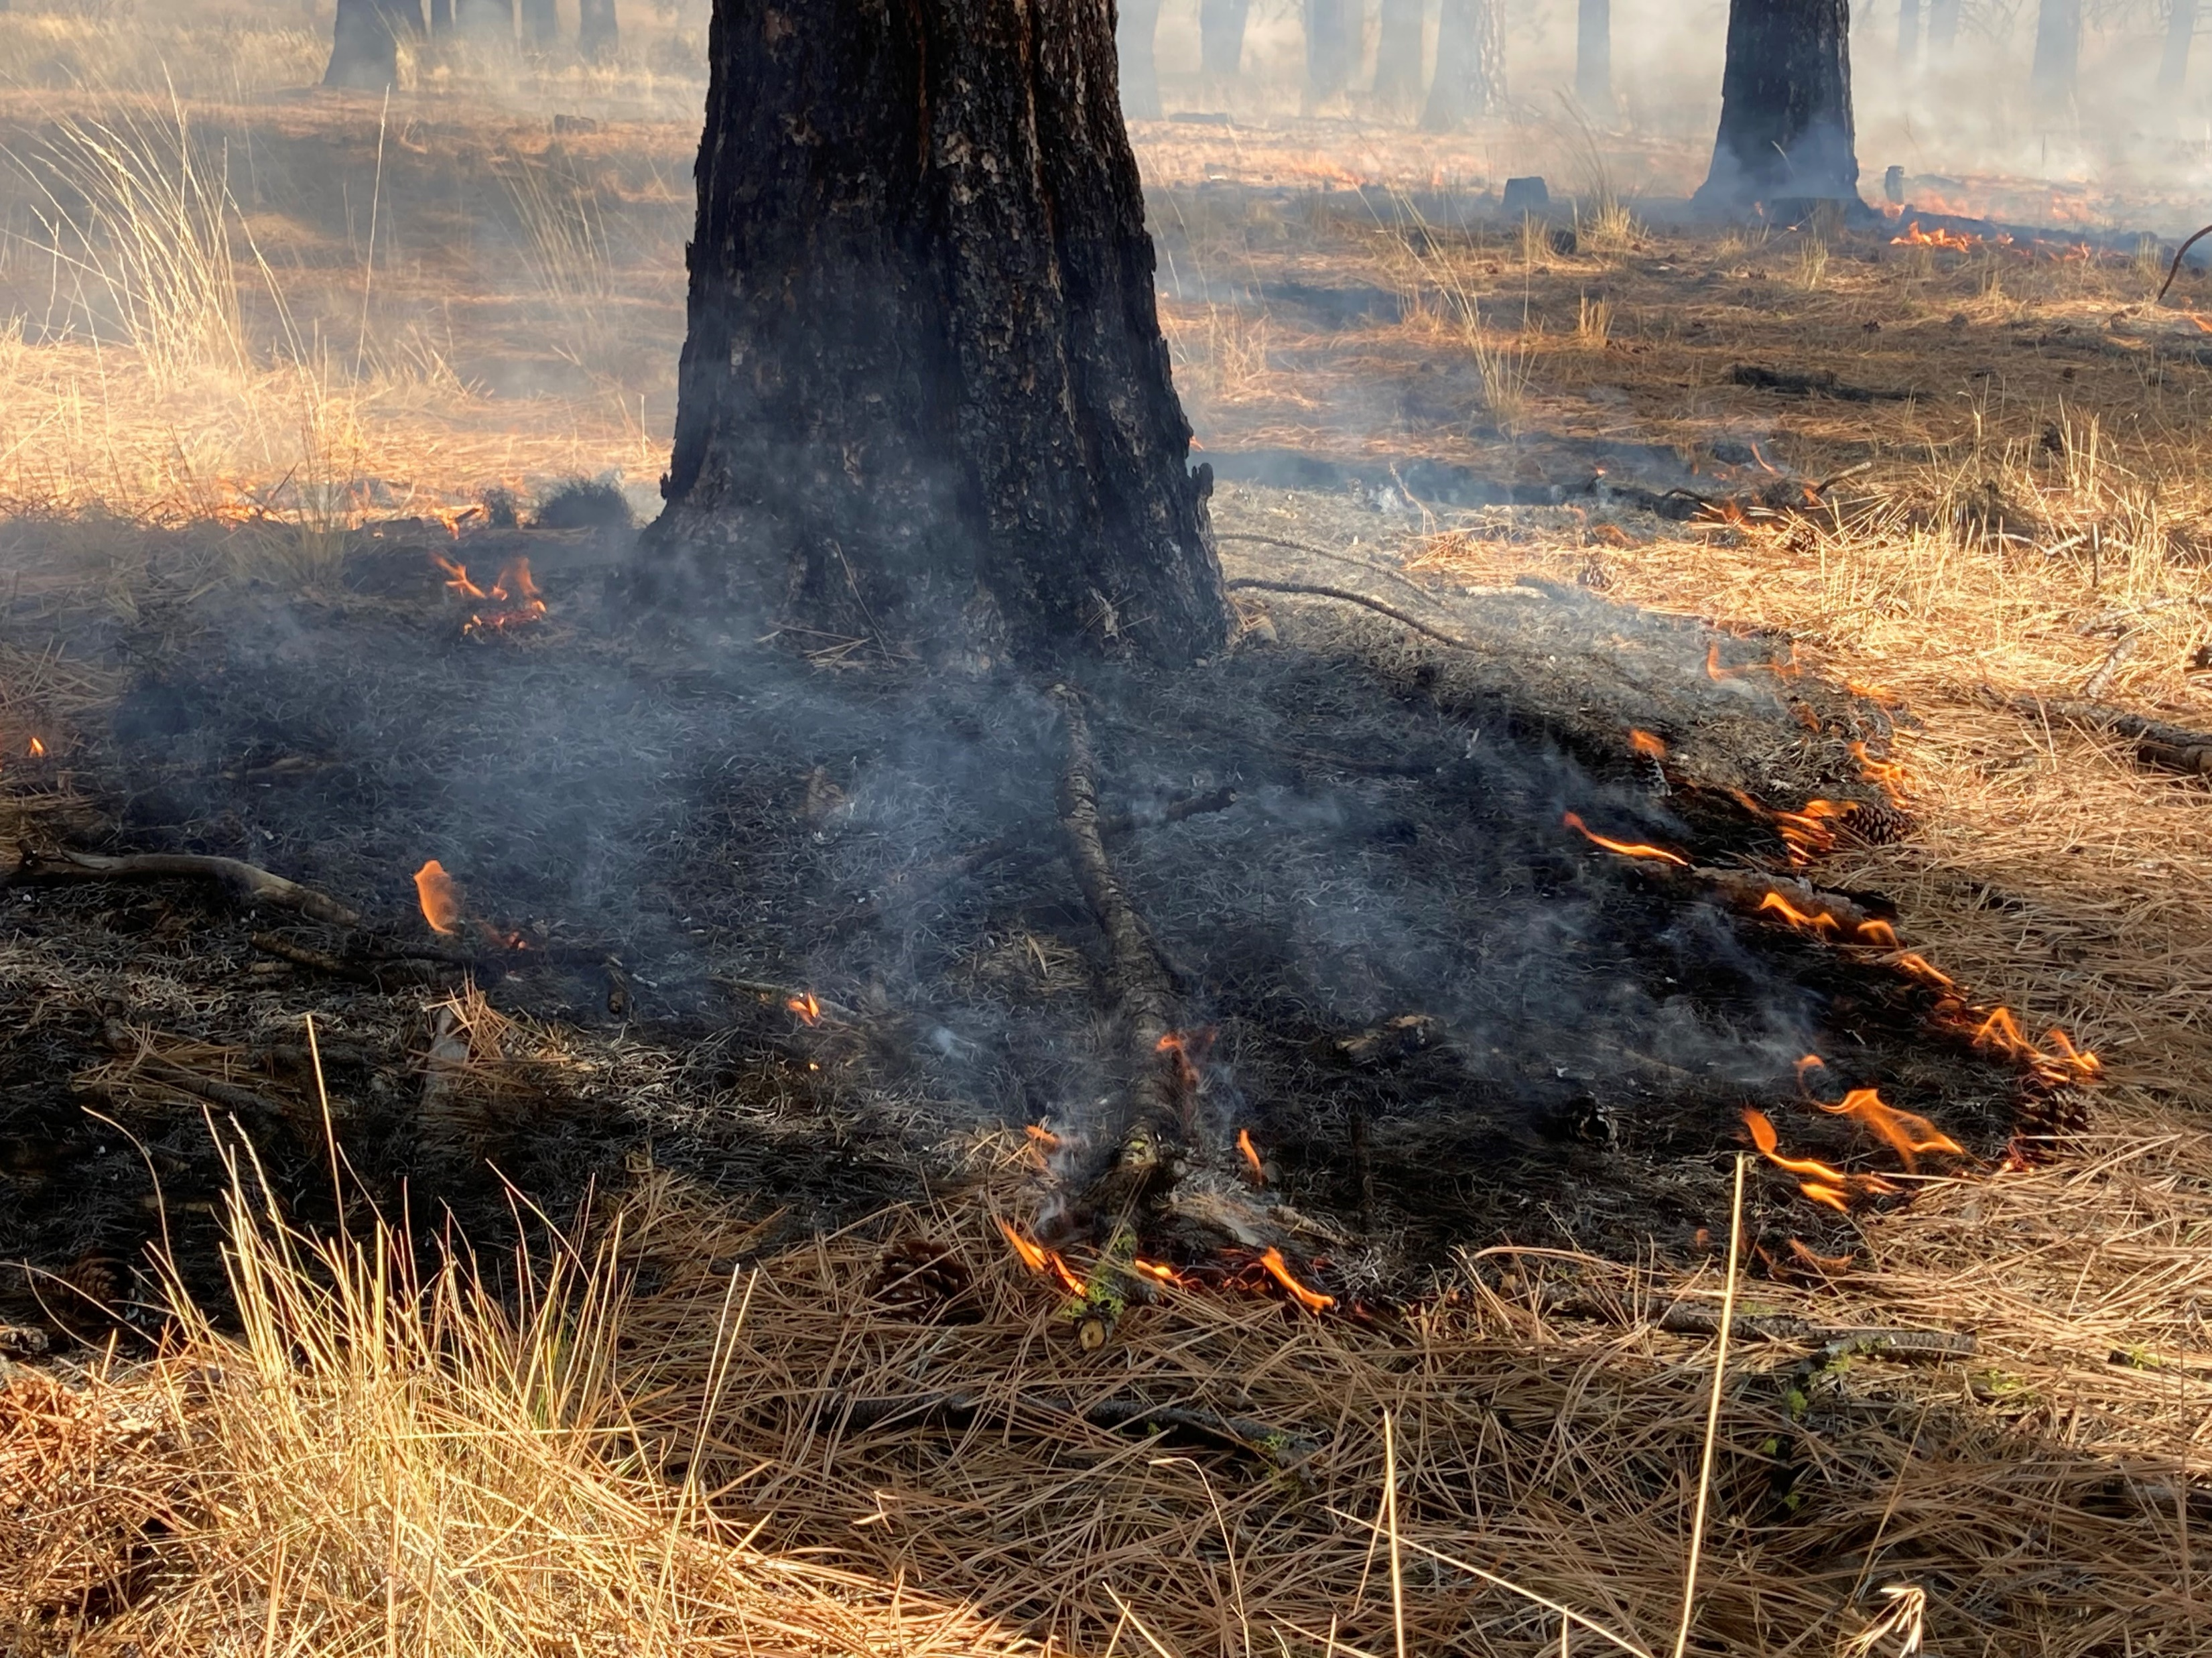
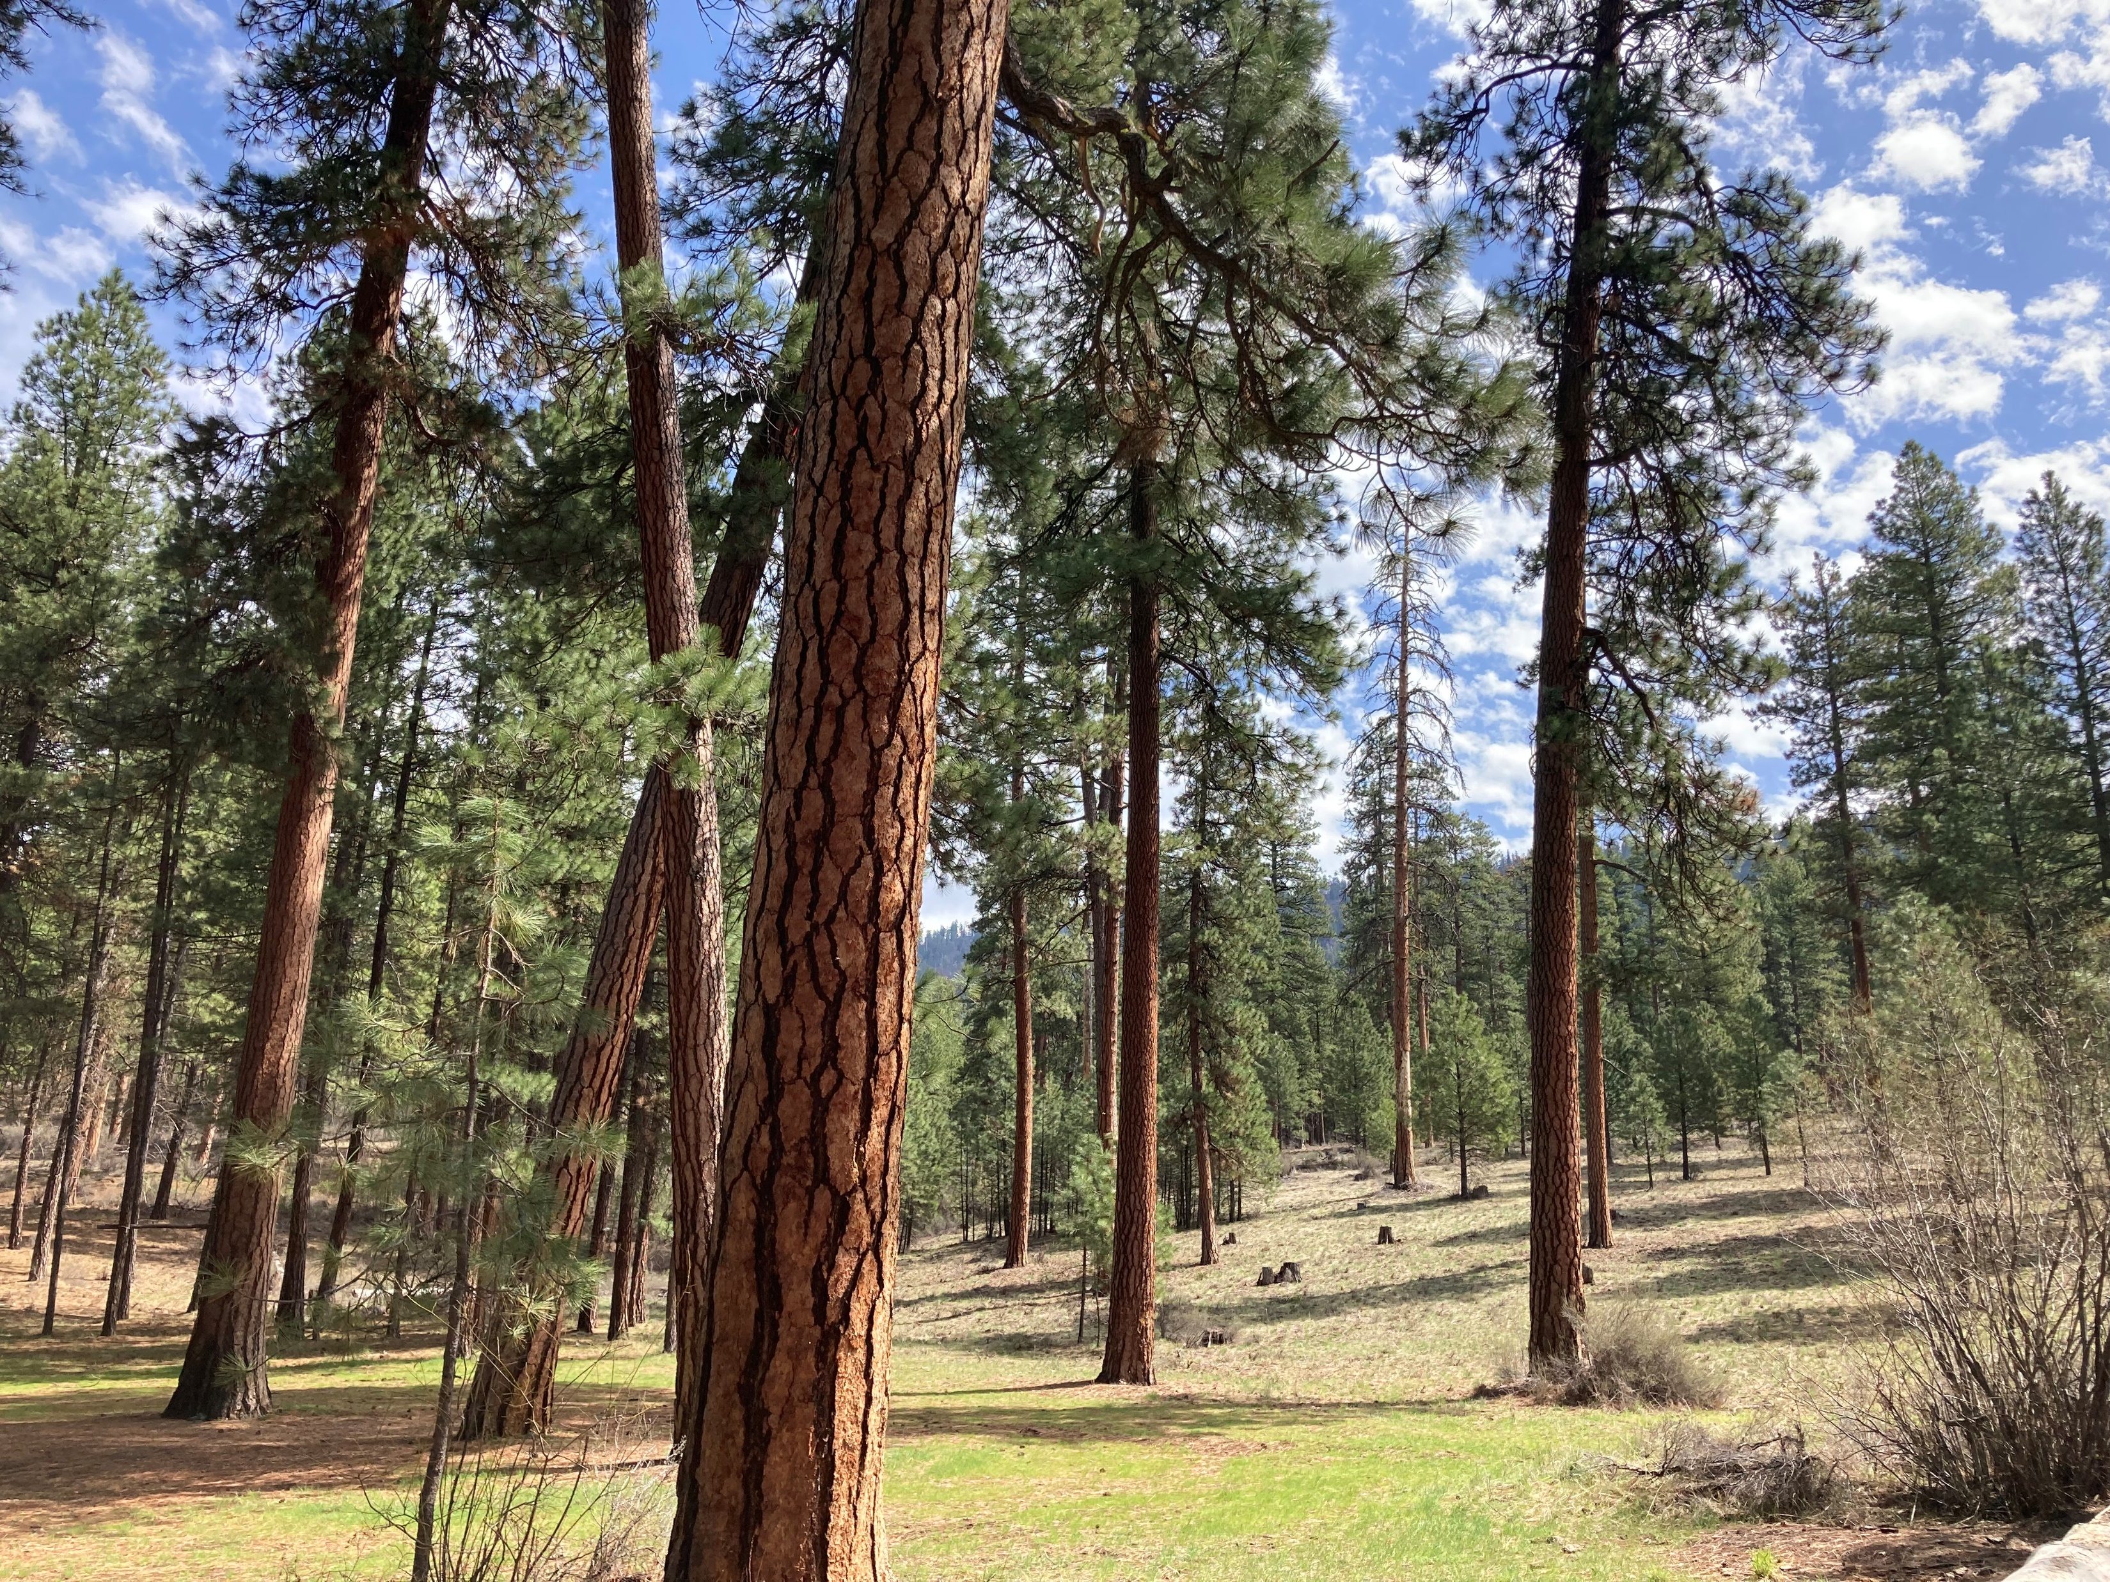

Building a prescribed fire database for the western United States
Kori Blankenship & Teresa Chapman
The Nature Conservancy
kblankenship@tnc.org - tchapman@tnc.org
Association for Fire Ecology Congress, December 2023

Slide 2
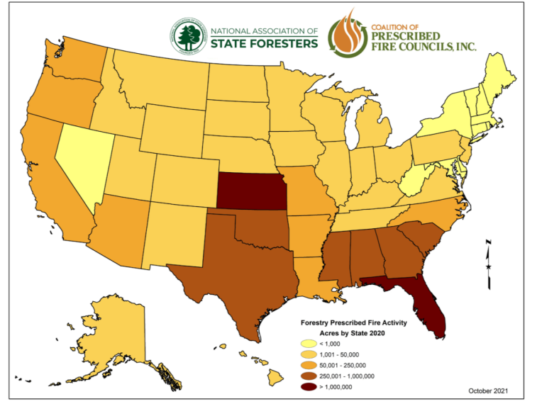
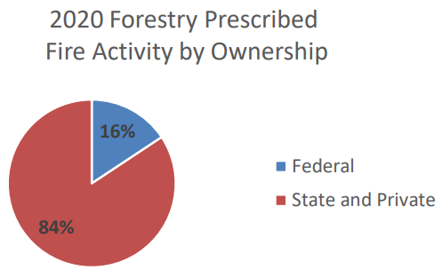
Background
Limited information on when and where prescribed fires occur on private land.
Prescribed fire use on all ownerships, 2020
Figures: 2021 National Prescribed Fire Use Survey Report, Coalition of Prescribed Fire Councils and the National Association of State Foresters
Notes:
Interested in fuel tx effectiveness when encountered by wildfire > need info on treatments
Several federal systems track treatments
No reporting system for all burns; no known public repository for burning on private lands
Info from rx fire use report provides coarse level estimate at state and regional level (map)
Decided to build a database based on public records
Interested in an all lands approach b/c:
Data suggests that US-wide most prescribed burning is happening on state and private land (pie chart)
Private lands transmit a lot of wildfire to national forests (Downing et al. 2022)
Report info: 2021-National-Rx-Fire-Use-Report_FINAL.pdf (prescribedfire.net)
-1.5 m acres fed burning; 7.9 acres state and private
-report uses the best info available from state forestry agencies; based on a survey of rx fire use data collected in 2020
-survey data covered all federal, state, and private rx burning activity that occurred specifically on forestlands and rangelands.
-Map from figure 2 in the report
Downing et al: s41598-022-06002-3.pdf ; paper on transmission of fire to Nat. Forest land

Slide 3
Objective
Create an all-lands prescribed fire records database for 11 western states
State | Information tracked |  |  |  | Years of data
 | Permitted acres | Requested acres | Completed acres | Burn type | pre-2010 | 2010 | 2011 | 2012 | 2013 | 2014 | 2015 | 2016 | 2017 | 2018 | 2019 | 2020 | 2021 | 2022
AZ
CA
CO
ID
MT
NM
NV
OR
UT
WA
WY
Notes:
Create an rx fire records database to get more complete picture of fire use in the West
Used public records requests to get state permits
Gathered ~275k records
Characteristics…(table)

Slide 4
Methods
Database attributes
Date
Latitude/Longitude
Acres permitted
Acres requested
Acres completed
Pile volume
Burn name
Burn type
Entity requesting
Cleaning
Standardizing
Calculating variables:
Unique burns: state, year, location, burn type, number, name
Planned acres: permitted acres if available, else max requested
Notes:
1. cleaning: fixed lat/lons, removed duplicate records
2. Standardizing – classified as burn/pile, removed ag and barrel burning, limited to overlapping years
3. Calculating variables of interest
Results presented are to provide insight into trends; not exact numbers
Caution against comparing numbers between states b/c I didn’t try to control for different reporting requirements in different states
States track rx burns for different reasons in different ways; I couldn’t resolve all of these differences
E.g. CA only requires reporting to PFIRS for fires >10ac; other states have emissions thresholds for reporting, ID seems to collect everything in the same system (including backyard barrel burning)

Slide 5
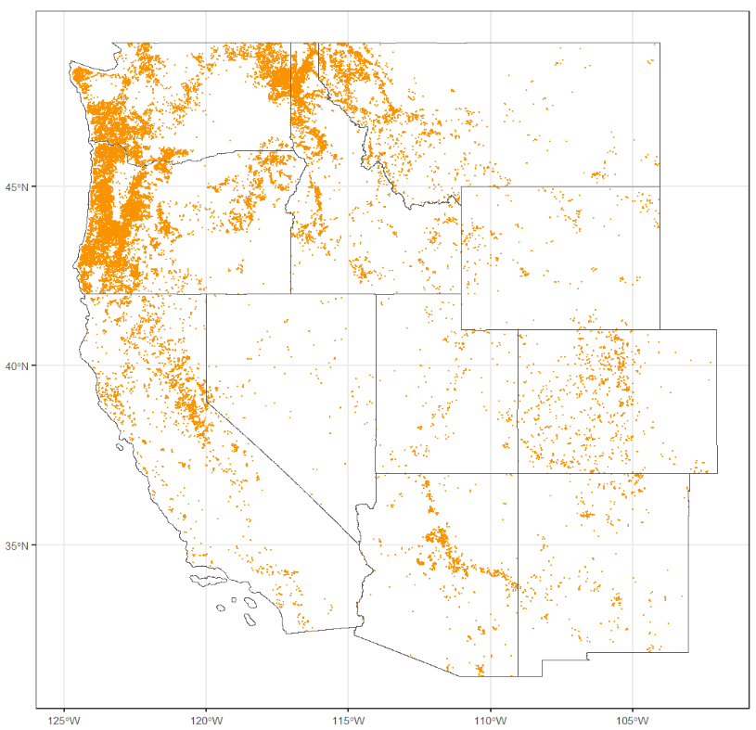
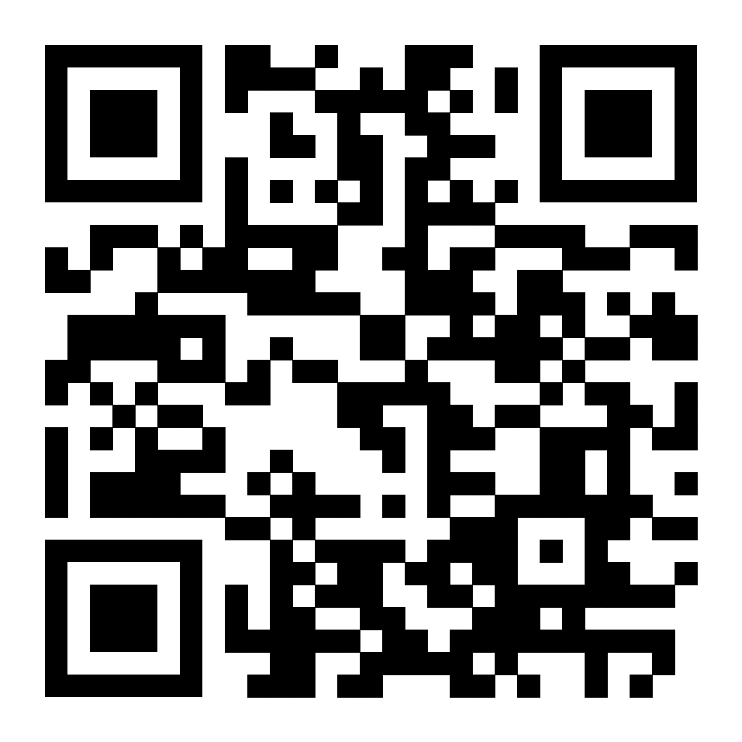
Results
Westwide –
Piles | 49,992
Broadcast | 6,065
Unknown | 575
Total | 56,632
Planned and completed burns 2017-2022
Draft interactive map:
https://koriblankenship.github.io/StateRx/map.html
Notes:
Geographic patterns
Break down of the points

Slide 6
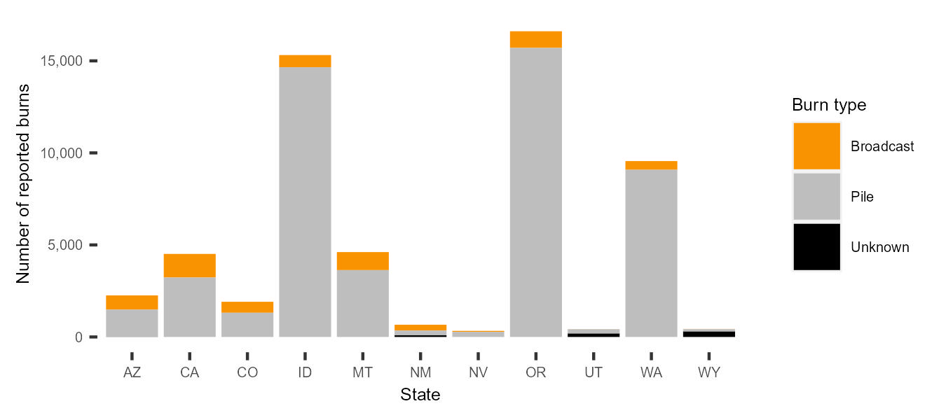
Results
Westwide - 8 times more pile than broadcast burns are reported.
Number of reported burns 2017-2022 (11 states)
Notes:
Reporting requirements differ from state to state: CA may be missing piles b/c of min 10 ac threshold for reporting

Slide 7
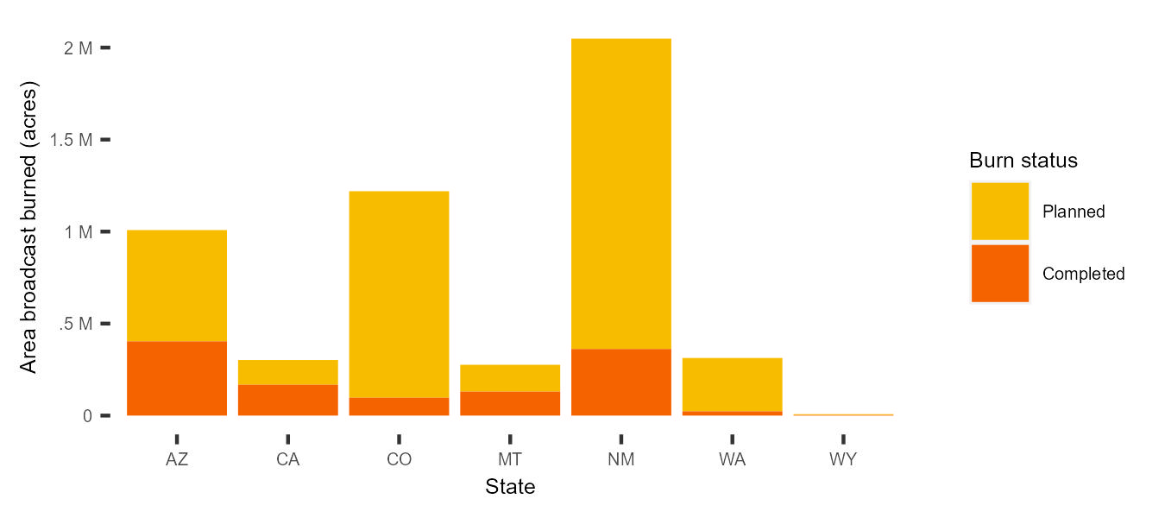
Results
Westwide – 23% of planned broadcast burns are completed.
Area of broadcast burns 2017-2022 (7 states)
Notes:
In some states I can’t calculate planned or completed; 7 states shown
Only reporting here for broadcast burns b/c tracking piles is more complicated
Piles reported in: acres, emissions volume, # piles, linear feet, etc
Piles are often not tracked consistently w/ in a state
Notes
Total of 1,345,896 acres westwide over 7 years; ~192,271 per year
Planned acres calculated as: permitted acres if available, otherwise max requested acres

Slide 8
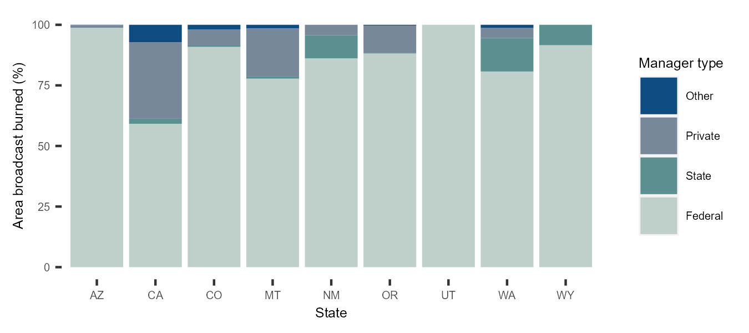
Results
Westwide - 86% of the area broadcast burned is on federal lands.
Percent area broadcast burned by land manager 2017-2022 (9 states)
Notes:
this is for completed broadcast burns
NOTES
~9% is private, the 2nd largest land ownership

Slide 9
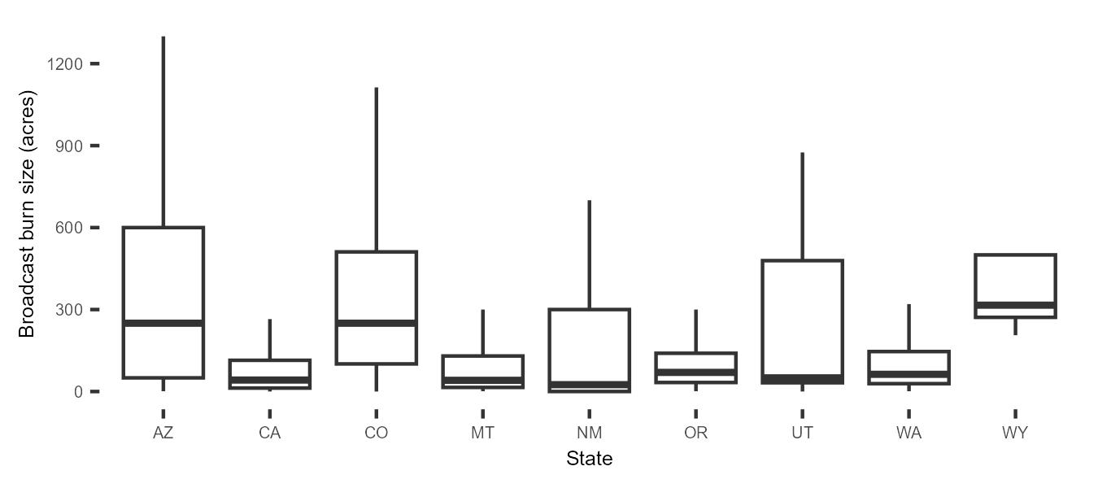
Results
Westwide - median completed broadcast burn size is 70 acres (mean = 331 acres).
Size of completed broadcast burns 2017-2022 (9 states)
Notes:
Median fire size is notable higher in AZ, CO, WY
Some 10,000+ acre burns bring the mean burn size up to 331 acres
Did not display outliers here b/c that makes it hard to see the box n’ whiskers, skewed data

Slide 10
Summary
More pile than broadcast burn records.
More broadcast burns are planned than completed.
Majority of broadcast burns occur on federal lands in the West.
Broadcast burns are relatively small in size.
Notes:
Data are incomplete, not perfect; w/o focusing on exact numbers, some trends emerge
General trends…2017-2022, in the West

Slide 11
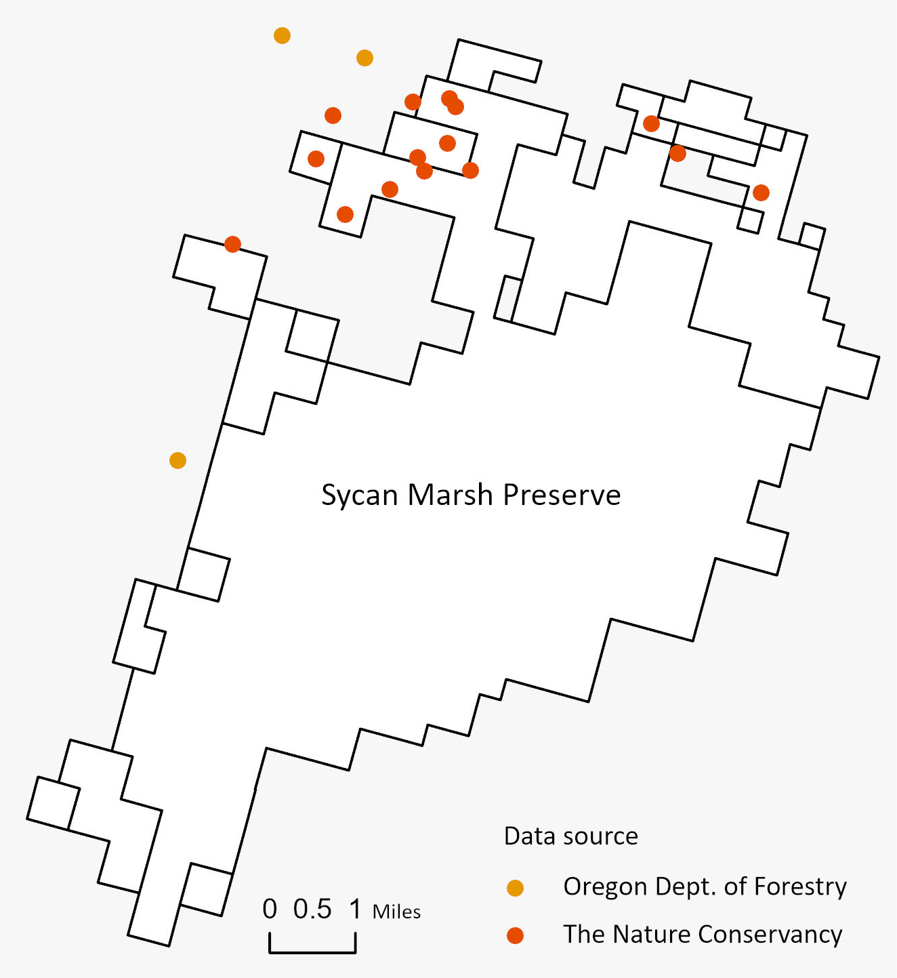
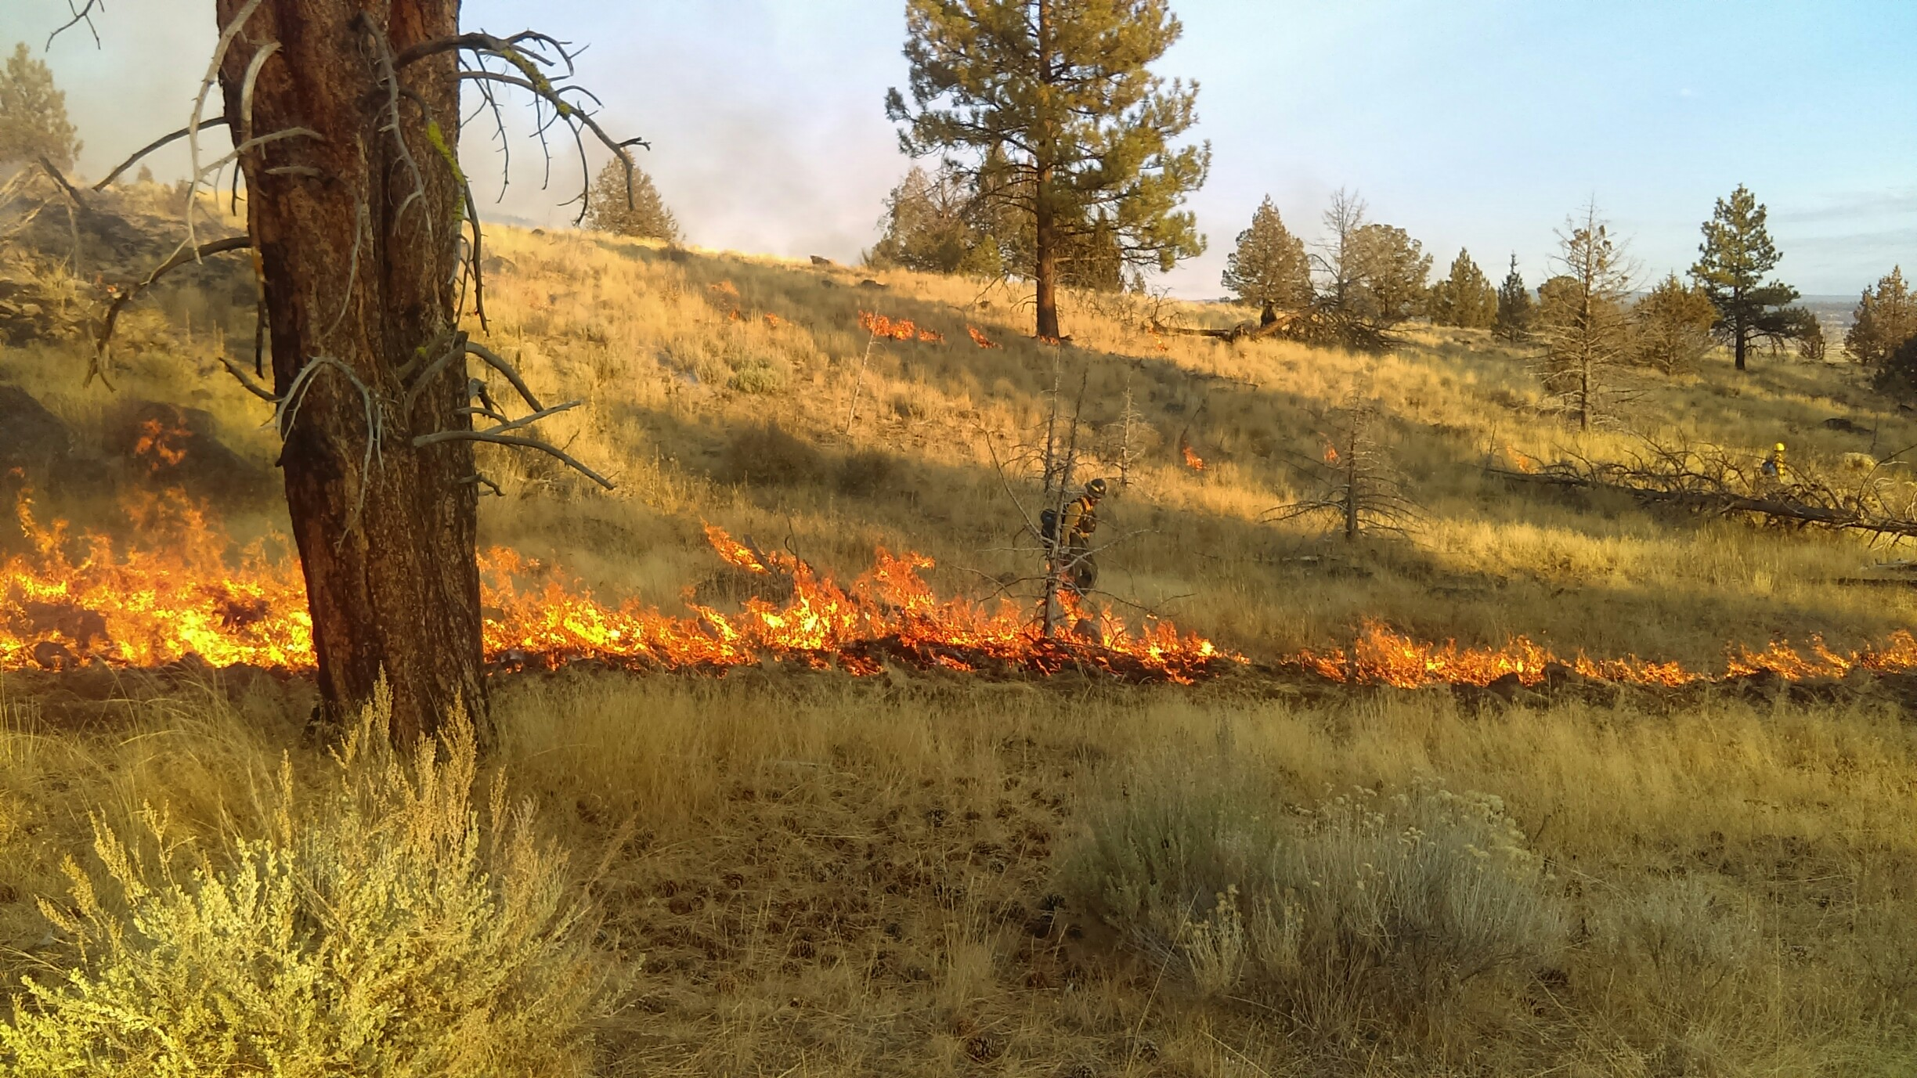
Next steps
Example of public records missing data on private land
Prescribed fire on The Nature Conservancy’s Sycan Marsh Preserve, OR.
Notes:
Build complete TNC rx database to estimate completeness of private land data
Example: ODF doesn’t have many TNC burns
Validation: imagery, other data sources (NFPORS, FACTS, SIT 209, Inform)
Other work in the database: e.g. maybe quantifying pile burning in a standard way

Slide 12
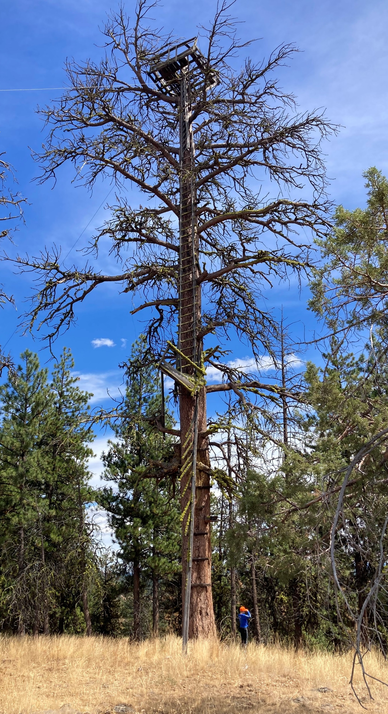
Opportunities
Leverage existing records systems to better understand completeness of Prescribed Fire Records Database.
Integrate Prescribed Fire Records Database with remotely sensed products to validate burn completeness and understand remote detection of prescribed fire.
Black Mountain Lookout tree, OR.
Notes:
An important take away from this effort is that our understanding of prescribed burning is limited due to lack of data consistency and completeness.
Picture: metaphor for how far we’ve come w/ wildfire intel; hopeful for advancement in Rx fire intel w/ efforts like SWERI, Timmons
Validate our database with existing treatment tracking systems; especially federal (FACTS, NFPORS),
Use products (e.g. usgs burned area, fired) to
validate if burns in our database occurred
Improve our understanding of what burns can be remotely sensed

